Slide 1
Architecture and hardware-software co-design of connectivity SoCs
Dr. J. ABSAR
javed.absar@gmail.com

Slide 2
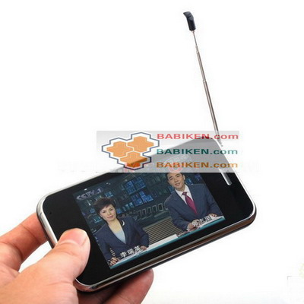
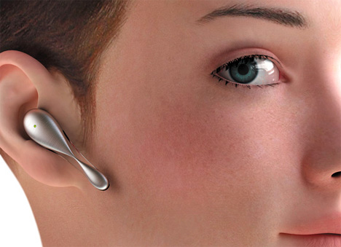
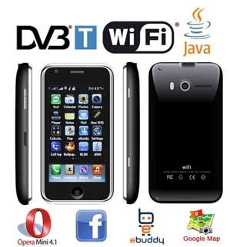
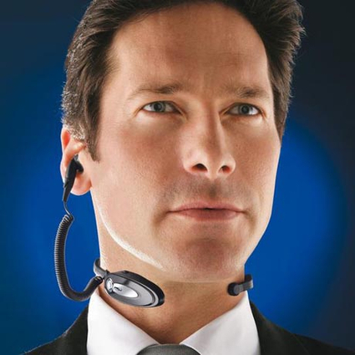
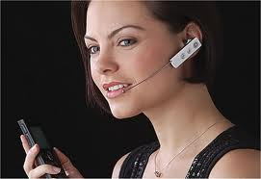
Context

Slide 3
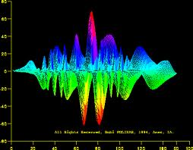
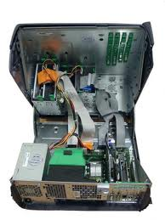
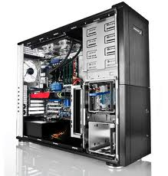
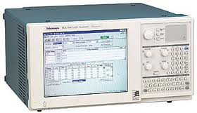
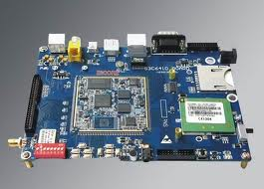
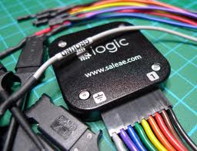
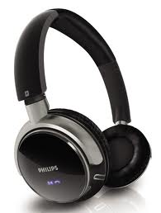
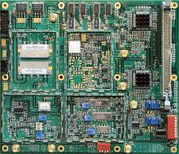
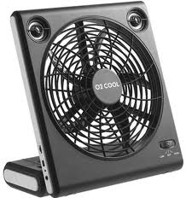
Overall System
Bluetooth
Digital
802.11
Digital
Bluetooth
RF
802.11
RF

Slide 4
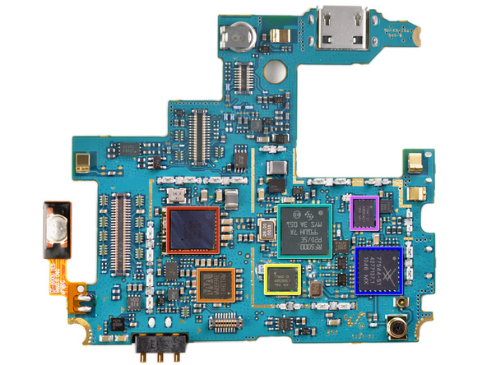
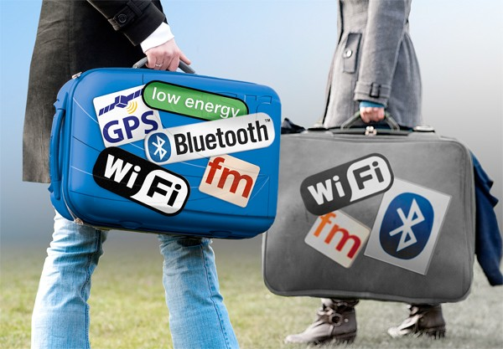
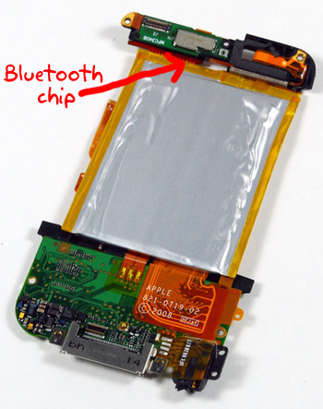
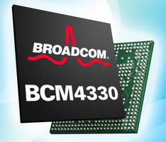
Context

Slide 5
Mobile Connectivity Market
Atheros, Broadcom, CSR, Marvell, Qualcomm, ST-Ericsson, and Texas Instruments
CellGuide, HelloSoft, Infineon, Intel, MediaTek, Nanoradio, Redpine, Silicon Labs, Skytraq, and Telechips
WiFi : Broadcom, Atheros, Intel, TI, Marvell, ST-Ericsson, Connexant
Bluetooth : CSR, Broadcom, TI, ST-Ericsson
Consolidation of wireless industry: ST+NXP+STE
All in one solution or BT \ WLAN \ GPS \ FM \

Slide 6
Overall System
WiFi Access Point
Headset
Bluetooth Slave
Mobile Phone
802.11 STA
Bluetooth Master

Slide 7
Overall System
Bluetooth
Digital
802.11
Digital
Bluetooth
RF
802.11
RF

Slide 8
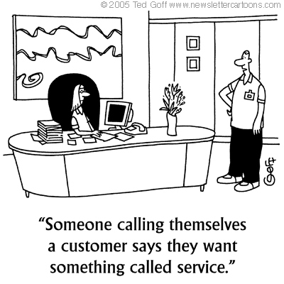
System Design
Requirement analysis
Feasibility of what the customer(s) demand [ e.g. data rates, low power, area]
Cost of what the customer demands
Benchmarking
Existing system performance
System architecture and prototyping
Mix of new knowledge and old knowledge

Slide 9
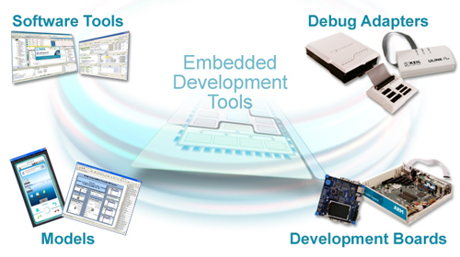
System Design
Network Simulator / Matlab Model
SystemC model (High Level Model) + C model
SystemC model (cycle accurate)
RTL Development & Verification
FPGA Testing (testing infrastructure)
FW Development (model + real)
System Integration
Chip (P1, P2, P-Final)
Customer side integration
SIMULATION
accuracy
speed

Slide 10
High Level System
uP
ARM?
Memories
uP
ARM?
Memories
ASIC (MAC)
ASIC
ASIC
PHY
Other components / connectors
Other components / connectors (SDIO etc)
Bluetooth
WLAN
FEM

Slide 11
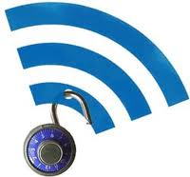
Coexistence System
Why ?
Sharing of medium, sharing of antenna
How ?
802.15.2 – high level methods (TDM, FDM)
Details to be worked out to make it work … start with use-case scenarios …

Slide 12
Use-case scenarios
web browsing (TCP DL) + voice (eSCO/SCO)
Talking on the hands-free while surfing the internet
You-tube (UDP) + music (A2DP)
Watching you tube on your phone and listening on the Bluetooth headset
File download (TCP DL) + voice
Talking on the phone while downloading a file

Slide 13
System Level Simulation
TCP/UDP/Application
TCP/UDP/Application
MAC SW (U) Layer
coex
istence
MAC SW (U) Layer
MAC SW (L) Layer
MAC SW (L) Layer
MAC HW Layer
MAC HW Layer
PHY Layer
(dedicated logic)
PHY Layer
(dedicated logic)
RF
FEM
RF

Slide 14
Hardware Software Co-design
HARDWARE
SOFTWARE
Pros –
Fast Response leading
to reliable behavior.
small footprint
Cons –
Change is expensive.
Extending, correcting,
re-architecting takes
TIME and MONEY
Pros –
Can keep changing,
Improving
Time to change is small
Cons –
Slow response,
unreliable behavior
Complicated sometimes
Do in HW only which you cannot do in SW

Slide 15
Conclusion
Designing a complex embedded system chipset requires expertise in several domains
Making mistakes in design kills the group
A great team and a great test environment is essential to a successful chip design

